Slide 1
Congestion Control Algorithms
Congestion
General Principles of Congestion Control
Approaches to Congestion Control
Congestion Control in Virtual-Circuit Subnets
Congestion Control in Datagram Subnets
Load Shedding
Jitter Control

Slide 2
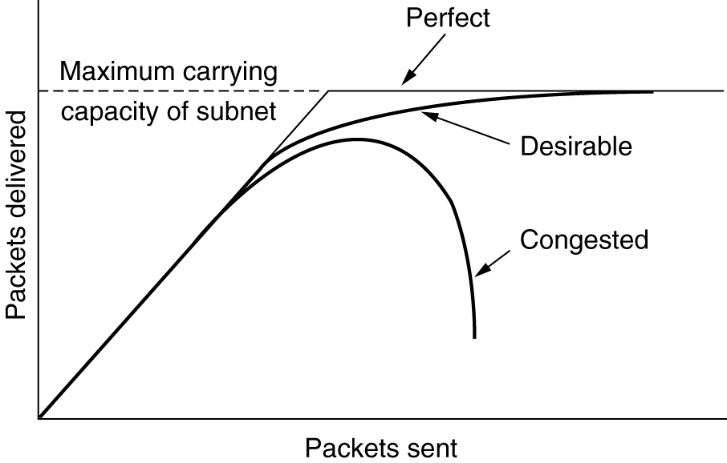
Congestion
When too many packets present in the network causes packet delay and loss that degrades performance. This situation is called congestion.
When too much traffic is offered, congestion sets in and performance degrades sharply.

Slide 3
General Principles of Congestion Control
Monitor the system .
detect when and where congestion occurs.
Pass information to where action can be taken.
Adjust system operation to correct the problem.
Approaches to Congestion Control
The presence of congestion means that the load is greater than the resources can handle.
There are two solutions:
Increase the resources,
Decrease the load.

Slide 4
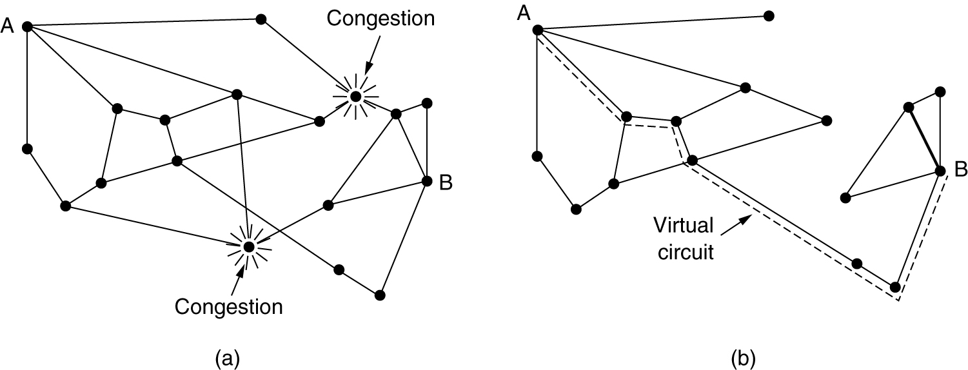
Congestion Control in Virtual-Circuit Subnets: Admission control
Sometimes it is not possible to increase capacity. The only way then to beat the congestion is to decrease the load..
Do not set up a new virtual circuit unless the network can carry the added traffic without becoming congested.
(a) A congested subnet. (b) A redrawn subnet, eliminates congestion and a virtual circuit from A to B.

Slide 5
Congestion Control in Datagram Subnets: Warning Bit
A special bit in the packet header is set by the router to warn the source when congestion is detected.
The bit is copied and piggy-backed on the ACK and sent to the sender.
The sender monitors the number of ACK packets it receives with the warning bit set and adjusts its transmission rate accordingly.

Slide 6
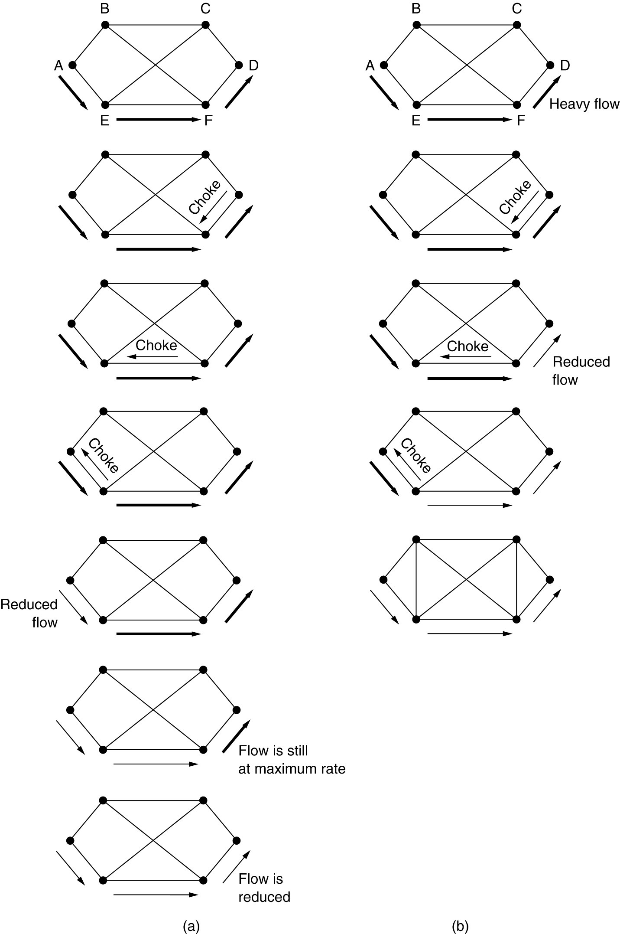
Choke Packets
&
Hop-by-Hop Choke Packets
(in high speed nets)
A more direct way of telling the source to slow down.
A choke packet is a control packet generated at a congested node and transmitted to restrict traffic flow.
The source, on receiving the choke packet must reduce its transmission rate by a certain percentage.
A choke packet that affects only the source.
(b) A choke packet that affects each hop it passes through.

Slide 7
Load shedding
When buffers become full, routers simply discard packets.
Which packet is chosen to be the victim depends on the application.
For a file transfer, for, e.g. cannot discard older packets since this will cause a gap in the received data.
For real-time voice or video it is probably better to throw away old data and keep new packets.
Get the application to mark packets with discard priority.

Slide 8
Random Early Detection (RED)
This is a proactive approach in which the router discards one or more packets before the buffer becomes completely full.
Each time a packet arrives, the RED algorithm computes the average queue length, avg.
If avg is lower than some lower threshold, congestion is assumed to be minimal or non-existent and the packet is queued.
If avg is greater than some upper threshold, congestion is assumed to be serious and the packet is discarded.

Slide 9
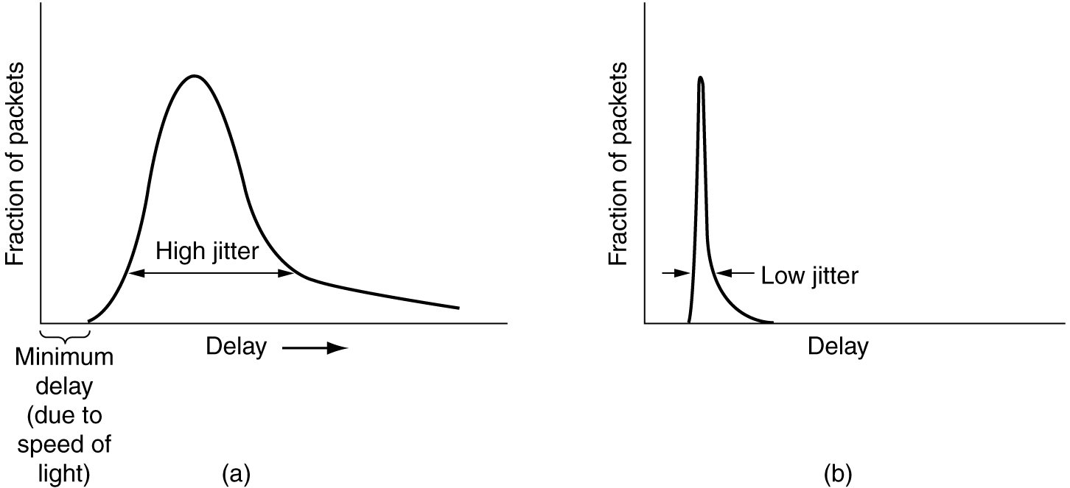
Jitter Control
The variation (i.e., standard deviation) in the delay or packet arrival times is called jitter.
(a) High jitter. (b) Low jitter.

Slide 10
Quality of Service
Four issues must be addressed to ensure quality of service:
What applications need from the network.
How to regulate the traffic that enters the network.
How to reserve resources at routers to guarantee performance.
Whether the network can safely accept more traffic.
Requirements
Techniques for Achieving Good Quality of Service
Integrated Services
Differentiated Services
Label Switching and MPLS

Slide 11
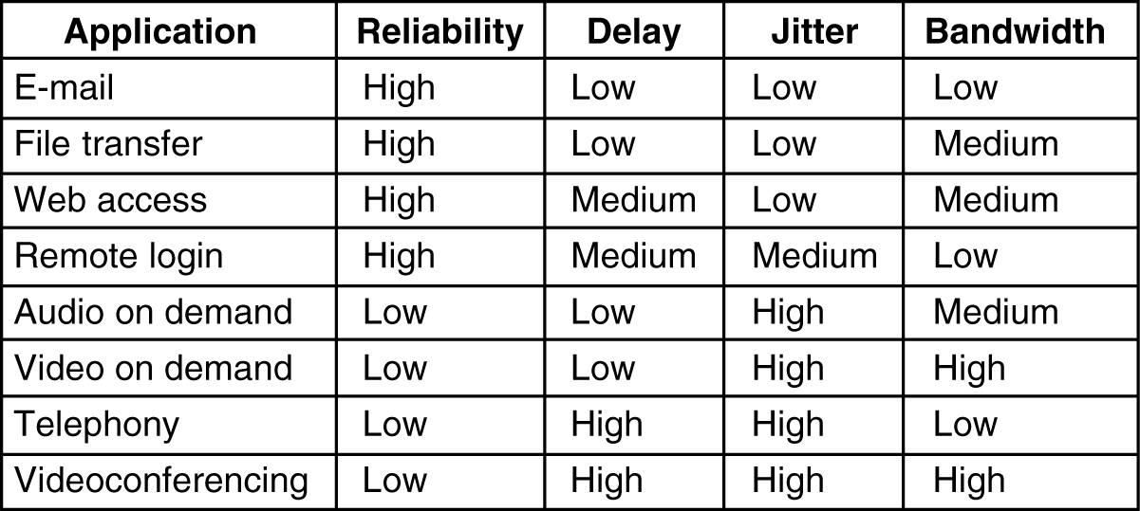
Requirements
5-30
How stringent the quality-of-service requirements are.

Slide 12
ATM networks classify flows in four broad categories wrt
their QoS demand:
Constant bit rate (e.g., telephony)
Real-time variable bit rate (e.g., video conferencing)
Non-real-time variable bit rate (e.g., video streaming)
Available bit rate (e.g., file transfer)

Slide 13
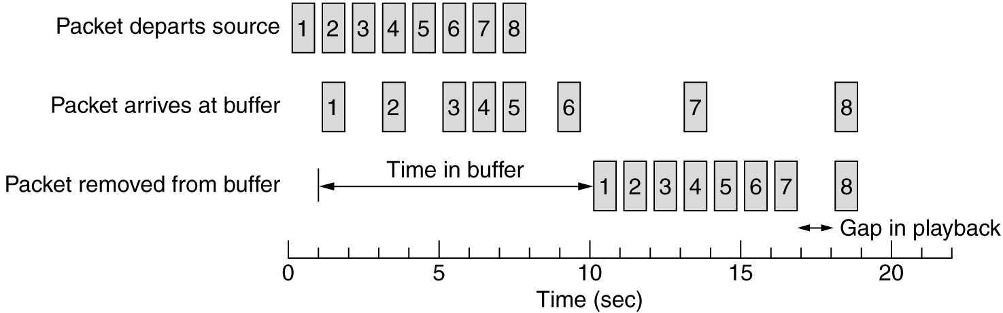
Buffering
Smoothing the output stream by buffering packets.

Slide 14
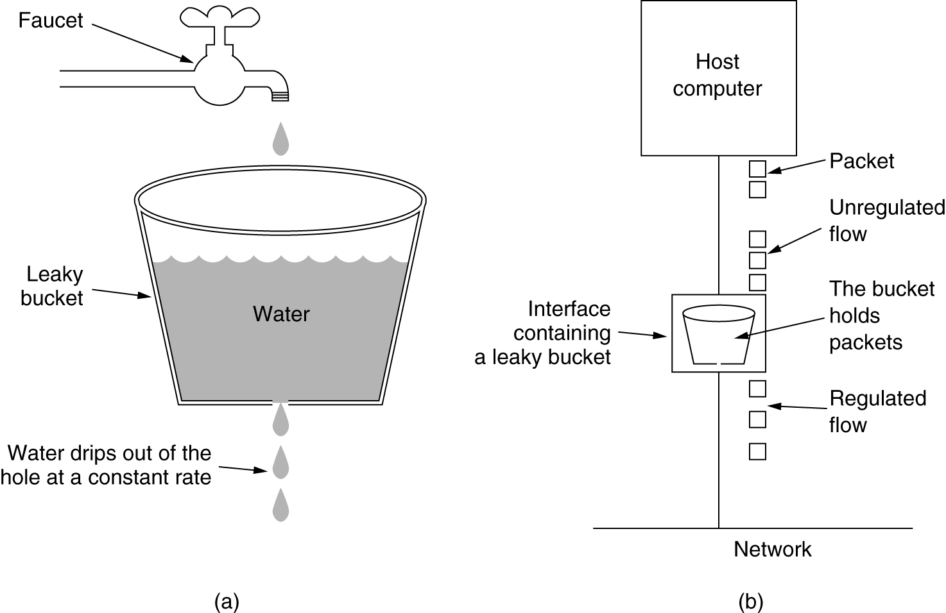
Traffic Shaping
The Leaky Bucket Algorithm
(a) A leaky bucket with water. (b) a leaky bucket with packets.

Slide 15
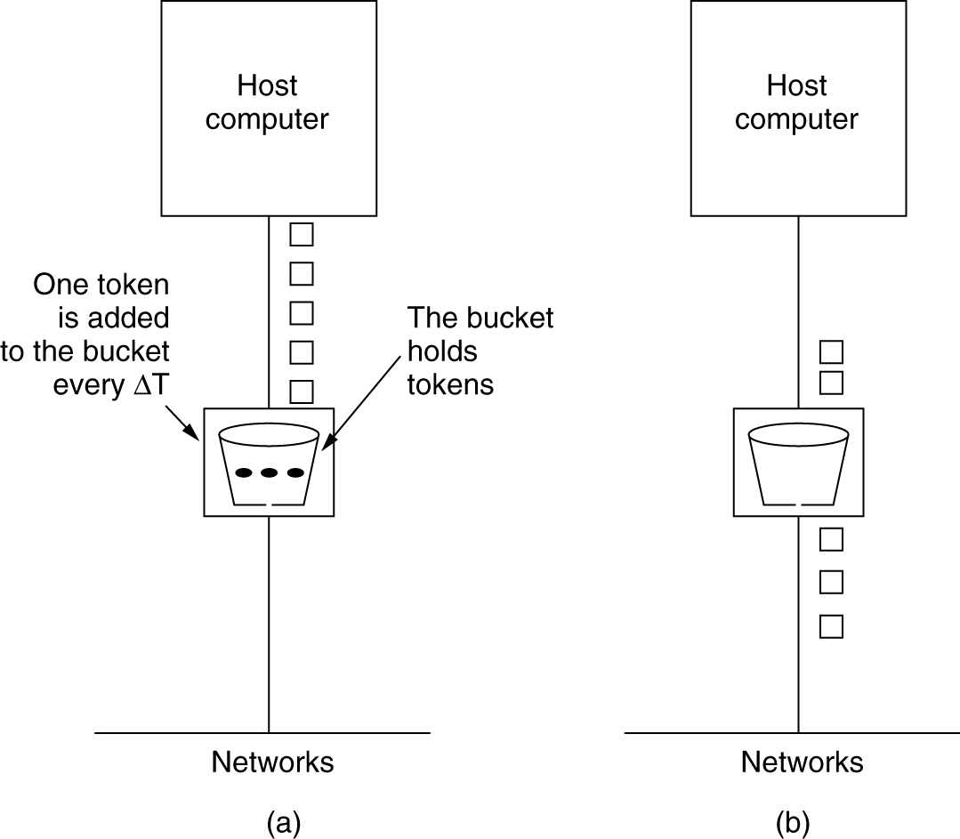
The Token Bucket Algorithm
5-34
(a) Before. (b) After.
Token bucket allows some burstiness (up to the number of token the bucket can hold)

Slide 16
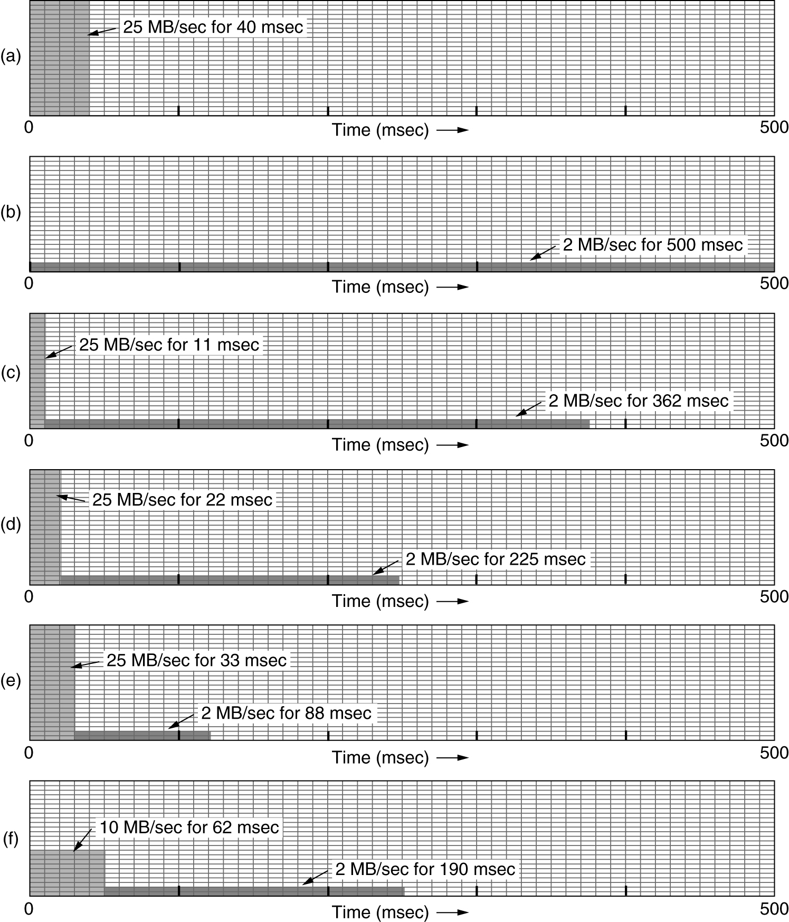
The Leaky and Token Bucket Example
(a) Input to a bucket. (b) Output from a leaky bucket. Output from a token bucket with capacities of (c) 250 KB, (d) 500 KB, (e) 750 KB, (f) Output from a 500KB token bucket feeding a 10-MB/sec leaky bucket.

Slide 17
Resource Reservation
Traffic shaping is more effective when all packets follow the same route.
We can, similar to virtual circuits, assign a specific route to a flow and then reserve resources along that route.
Three kinds of resources can be reserved:
Bitrate
Buffer space
CPU cycles

Slide 18
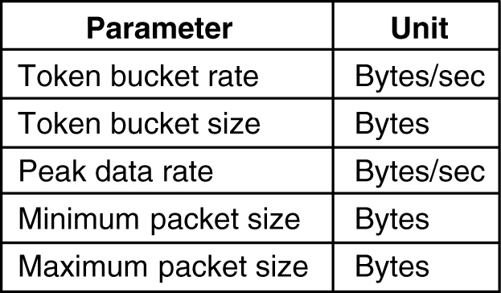
Admission Control
We saw, resource reservation but how can the sender specify required resources ? Also, some applications are tolerant of occasional lapses is QoS. Also, apps might not know what its CPU requirements are.
Hence routers must convert a set of specifications to resource requirements and then decide whether to accept or reject the flow.
An example of flow specification.

Slide 19
Proportional Routing
The idea here very different from what we have seen earlier. Here multiple paths are assigned to each flow and a appropriate fraction of the flow is sent simultaneously over each path.
This technique is also called Multipath routing.

Slide 20
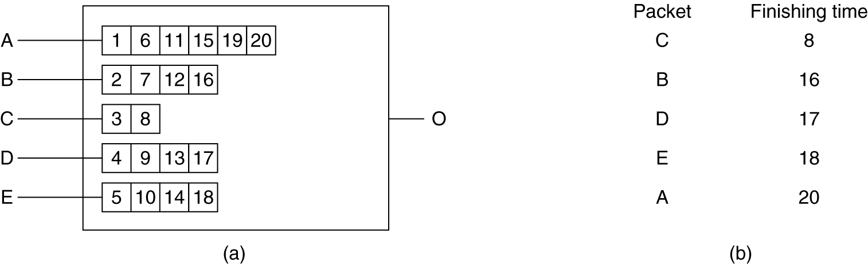
Packet Scheduling
If a router handling multiple flows uses first-come first-served method to process packets, there is possibility of some flows being starved.
Fair queuing
Weighted fair queuing
(a) A router with five packets queued for line O.
(b) Finishing times for the five packets.

Slide 21
Integrated Services (IntServ)
A flow-based approach to QoS using resource reservation.
Set of protocols aimed at streaming multimedia and standardized by the IETF.
Allows both unicast and multicast transmissions.
Resource reSerVation Protocol (RSVP) is used to reserve the resources at intermediate routers between sender and receivers.
RSVP allows:
Multiple senders to transmit to multiple groups of receivers
Permits individual users to switch channels freely
Optimises bandwidth utilization while simultaneously eliminating congestion.

Slide 22
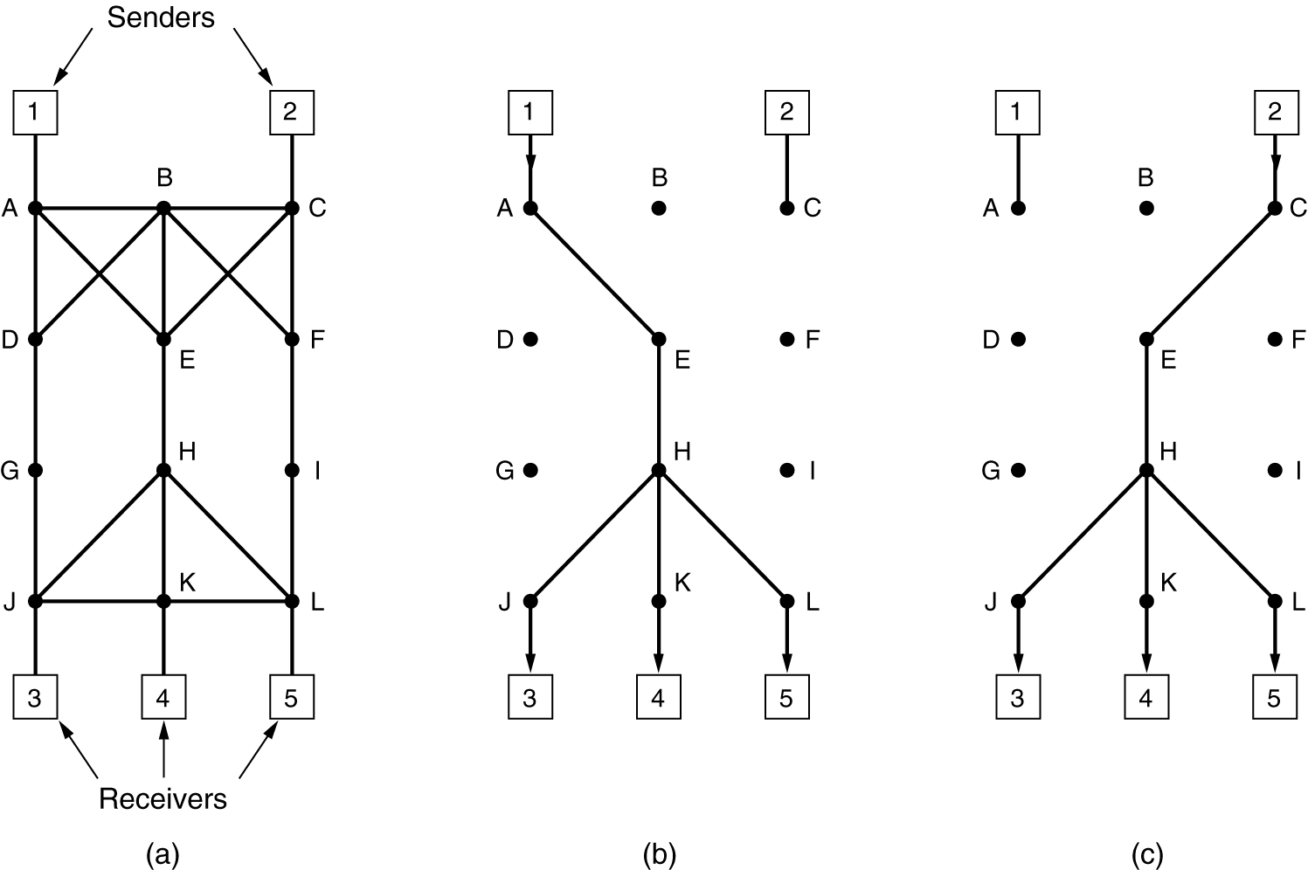
RSVP-The ReSerVation Protocol
Bandwidth reservation is done with reverse path forwarding along the spanning tree.
A network, (b) The multicast spanning tree for host 1. (c) The multicast spanning tree for host 2.

Slide 23
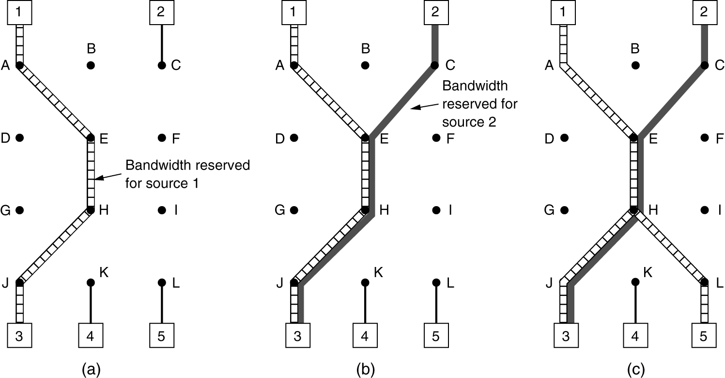
RSVP-The ReSerVation Protocol (2)
(a) Host 3 requests a channel to host 1. (b) Host 3 then requests a second channel, to host 2. (c) Host 5 requests a channel to host 1.

Slide 24
A lighter approach to QoS
IntServ is very powerful but has some severe drawbacks:
- There is a setup phase, this cases delay in starting data flow.
- Routers need to maintain per-flow state. This approach is flow-based and not very scalable.
- Complex router-to-router exchange of flow information.
A simpler and approach was then designed by the IETF called, Differentiated Services (DiffServ).
DiffServ takes a class-based (as opposed to IntSev flow-based) approach to QoS

Slide 25
Differentiated Services (DiffServ)
Introduces services classes with corresponding forwarding rules.
Network operator can “sell” services. Every incoming packet carries a Type of Service field. Depending on the service class of a packet, it may receive preferential treatment. The number of classes are decided by the network operator.
Idea similar to overnight, two-day and surface delivery in courier services.
Two simple classes are: Regular and expedited.

Slide 26
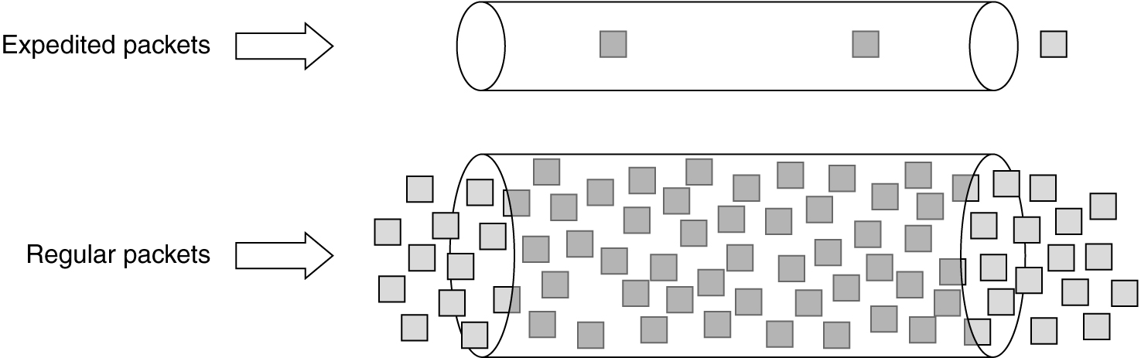
Expedited Forwarding
Expedited packets experience a traffic-free network,
e.g., if 10% of the traffic is expedited and 90% regular,
20% bandwidth is dedicated to expedited traffic.

Slide 27
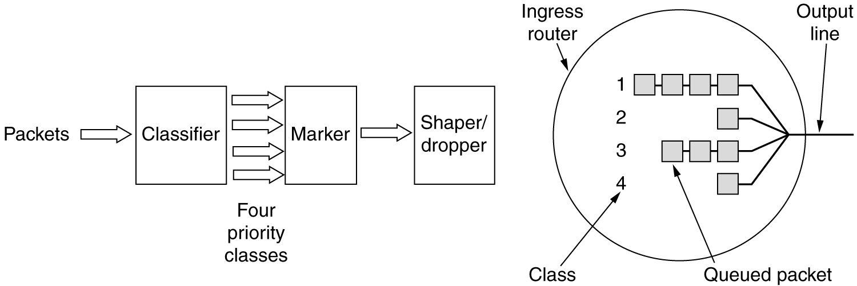
Assured Forwarding
A possible implementation of the data flow for assured forwarding.
There are 4 priority classes and 3 discard probabilities:
low, medium, high.

Slide 28
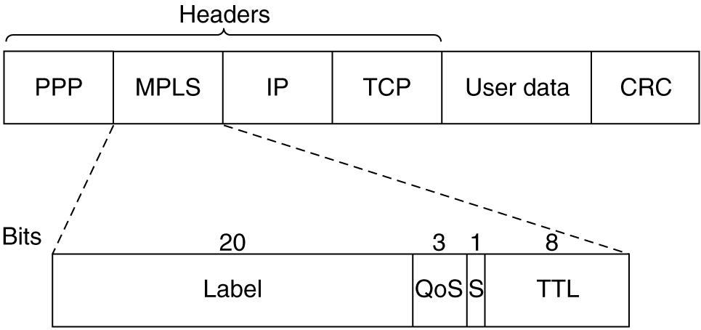
Label Switching and MPLS
Vendors, developed label switching/tag switching now called
MPLS (MulitProtocol Label Switching) by the IETF.
Idea is to apply labels to every packet and route using these labels.
Transmitting a TCP segment using IP, MPLS,
and PPP (router-to-router).

Slide 29
Label Switching and MPLS
Comparison with virtual circuit techniques:
Similarities:
- Both used tags/circuit ids.
- Both lookup forwarding tables based on these tags.
- Tags have link local significance only.
Difference:
- There is no setup phase in MPLS.
- MPLS tags routes and not end-point processes (no transport id), so greater aggregation is possible. All MPLS circuits to a host can use the same tags. In ATM, only cells to the same application can use the same tag.

Slide 30
Internetworking
How Networks Differ
How Networks Can Be Connected
Concatenated Virtual Circuits
Connectionless Internetworking
Tunneling
Internetwork Routing
Fragmentation

Slide 31
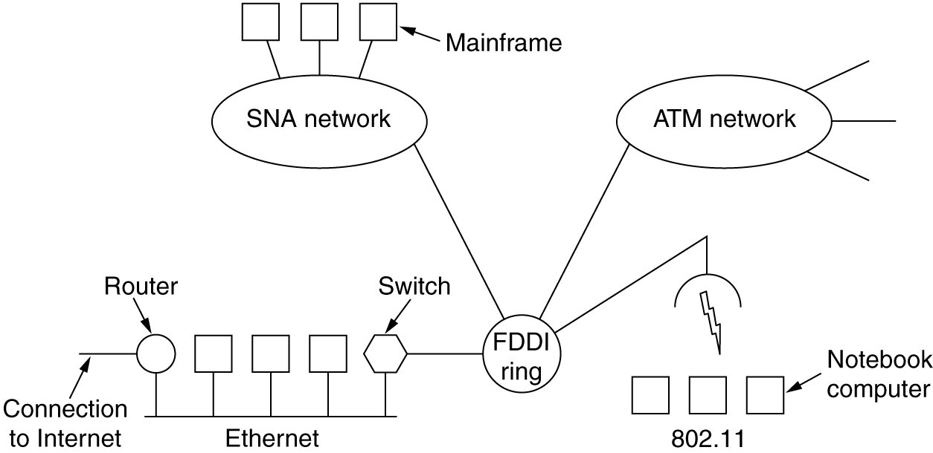
Connecting Networks
A collection of interconnected networks.

Slide 32
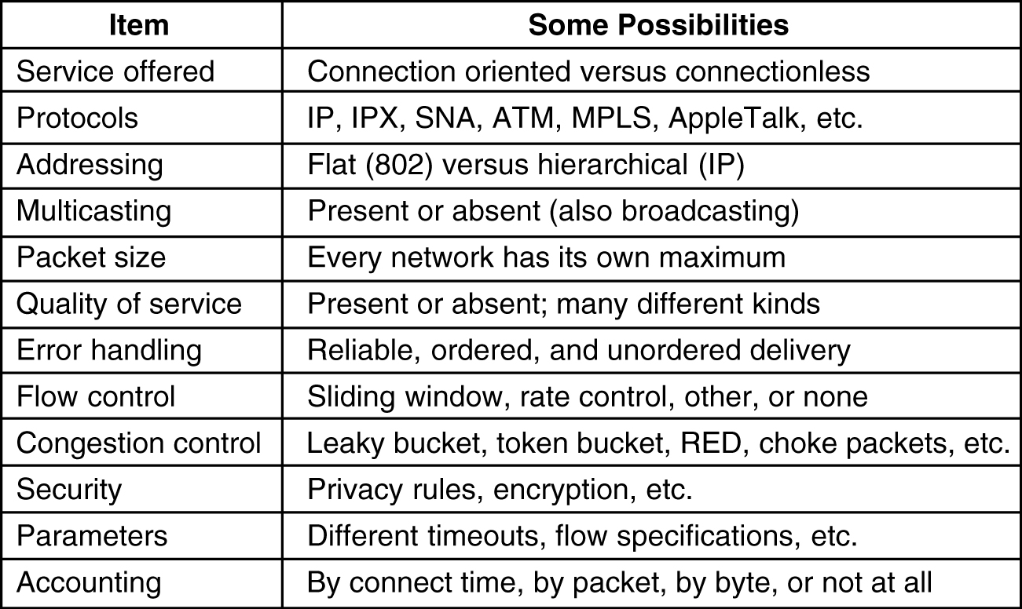
How Networks Differ
5-43
Some of the many ways networks can differ.

Slide 33
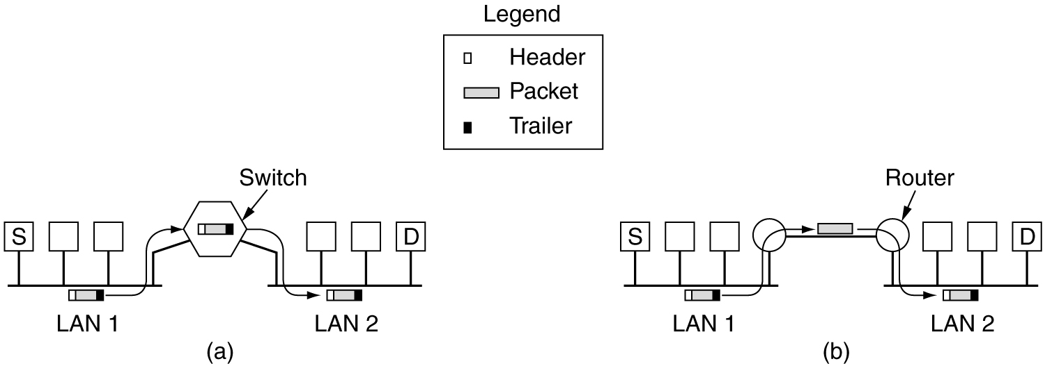
How Networks Can Be Connected
(a) Two Ethernets connected by a switch (data link layer).
(b) Two Ethernets connected by routers (network layer).

Slide 34
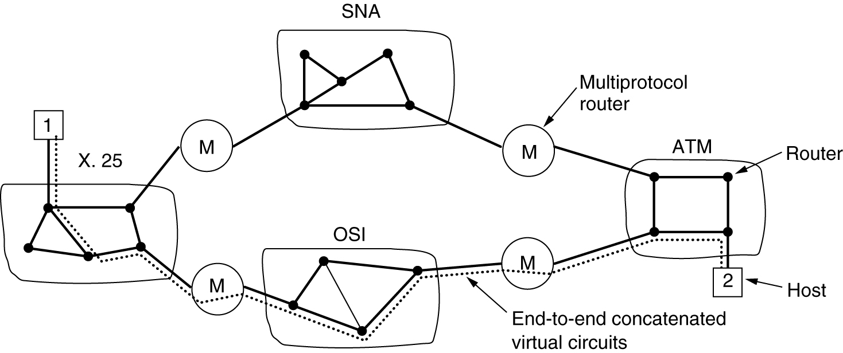
Concatenated Virtual Circuits
Networks can be connected using connection-oriented techniques. This allows easier QoS between disparate networks.
Only subnets internally using VCs can be connected this way.
Internetworking using concatenated virtual circuits
with gateways (multiprotocol routers).

Slide 35
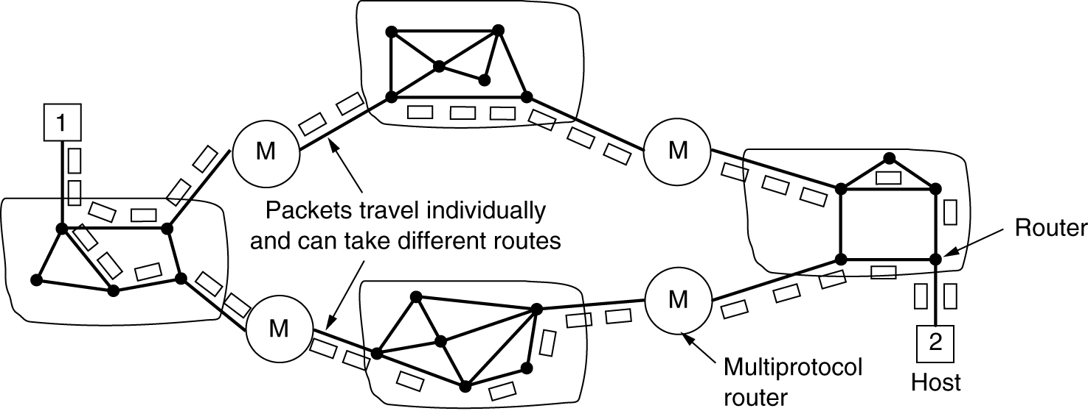
Connectionless Internetworking
A connectionless internet.

Slide 36
Comparing internetworking approaches
Connection oriented:
Advantages:
- Buffers can be reserved in advanced
- Sequencing can be guaranteed
- Short headers
Disadvantages:
- No alternate routing around congestion.
- vulnerability to router failures
- tables space at routers
Connectionless oriented:
Advantages:
- Can be used to connected subnets without VCs inside.
- Robust to router failures
Disadvantage:
- No sequencing
- Longer headers

Slide 37
Internet Protocol (IP)
The idea is to design another protocol, independent of datalink layer protocols, so that its packets can be encapsulated over many datalink layer protocols.
Then when you want to transfer data between different subnets, a multiprotocol router:
(1) extracts the IP packet from datalink layer frame on one subnet,
(2) encapsulates into datalink layer frame of another subnet
(3) send the new frame
IP allows diverse datalink layer subnets to exchange data. It is connectionless.

Slide 38
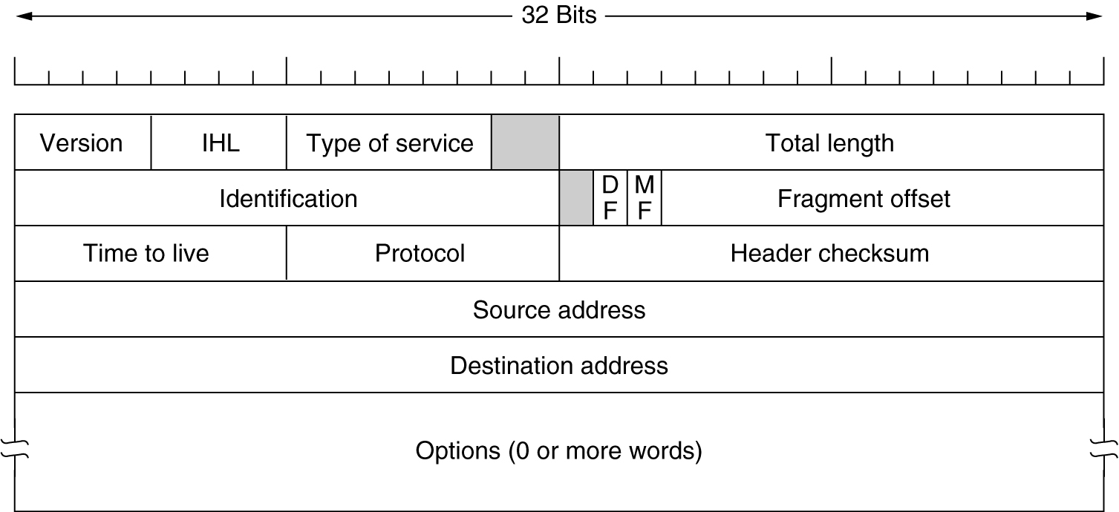
The IP Protocol
The IPv4 (Internet Protocol) header.

Slide 39
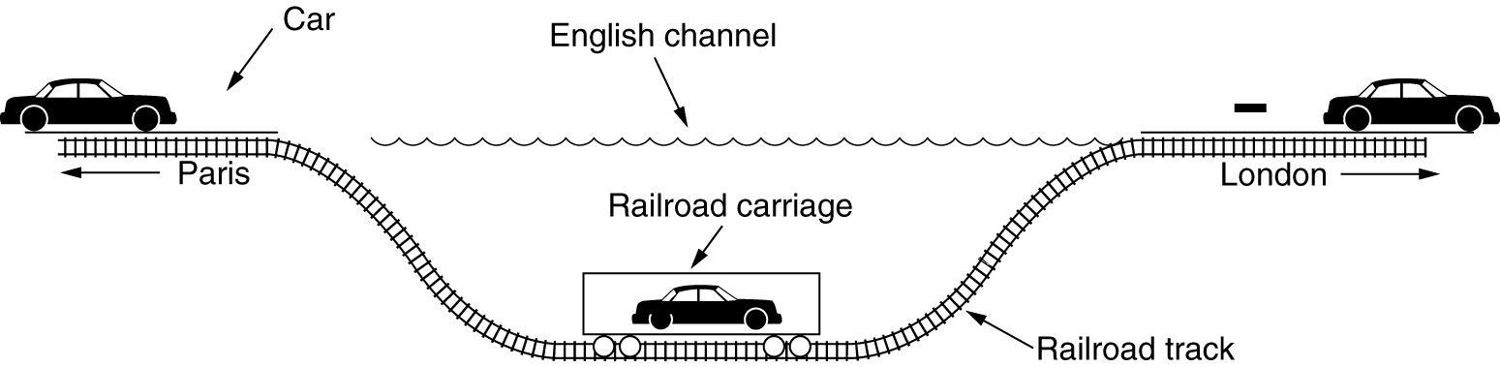
Interworking of two different networks
is difficult. A solution to a special case is tunneling.
Tunneling a car from France to England.

Slide 40
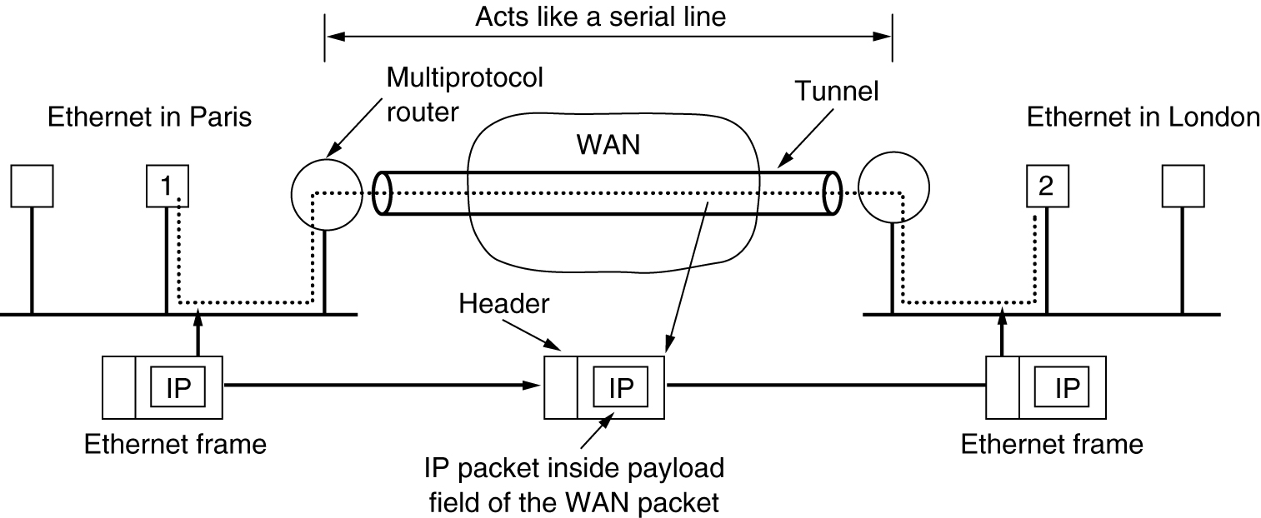
Tunneling (packets)
Tunneling a packet from Paris to London.

Slide 41
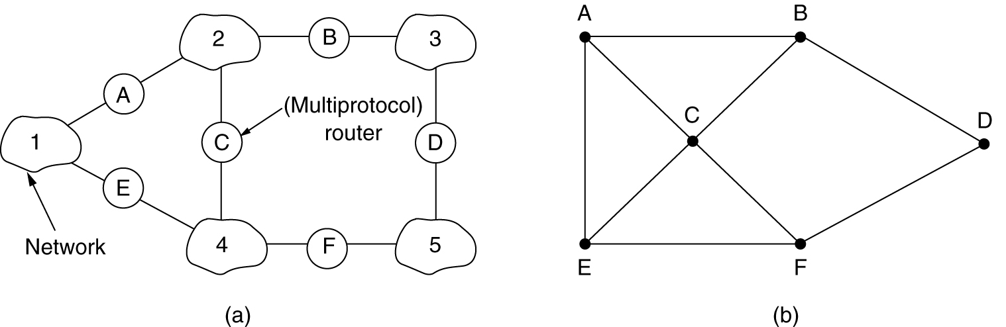
Internetwork Routing
An internetwork. (b) A graph of the internetwork.
Two-level routing:
Interior gateway protocol is used within each network
Exterior gateway protocol is used between networks
Gateway is a multiprotocol router.

Slide 42
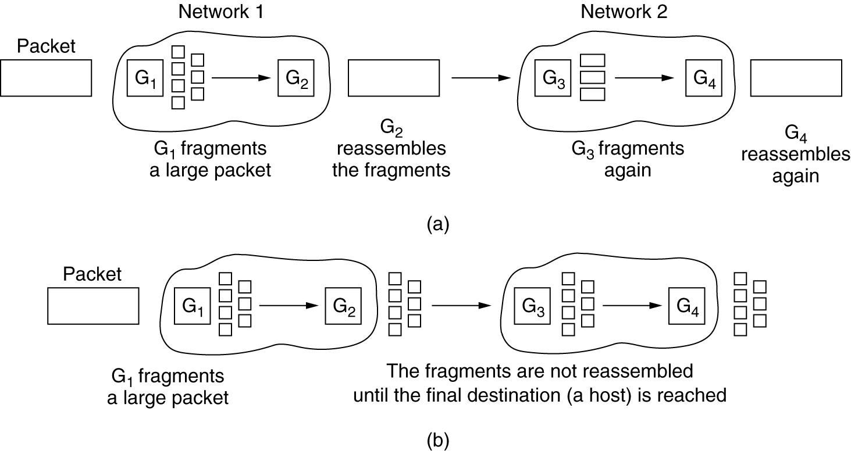
Fragmentation
Transparent fragmentation (ATM, reassembly at the exit gateway).
Nontransparent fragmentation (IP, reassembly at the receiver host).

Slide 43
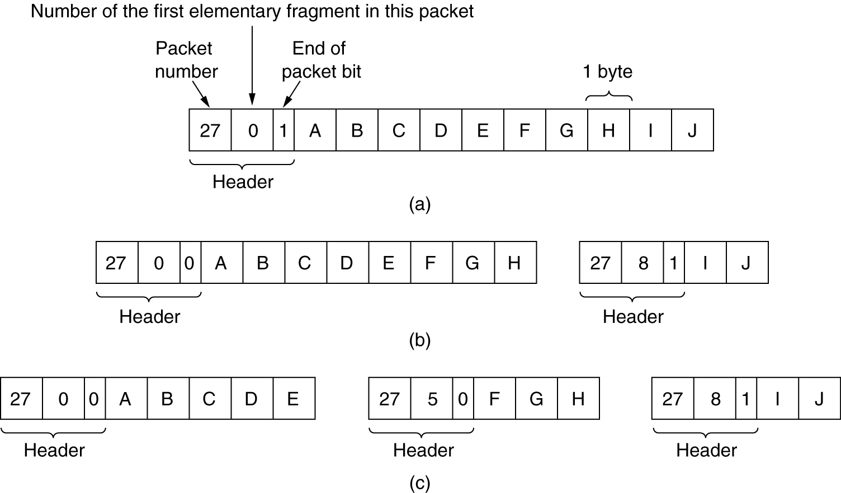
Fragmentation (2)
Fragmentation when the elementary data size is 1 byte.
(a) Original packet, containing 10 data bytes.
(b) Fragments after passing through a network with maximum packet size of 8 payload bytes plus header.
(c) Fragments after passing through a size 5 gateway.

